Slide 1
Composing like a human : Adapting generative networks to few-shot learning in the musical domain
Tudor Paisa | 2019551 | 315146
Tilburg University, March 21 2019

Slide 2
Introduction
Deep Learning as a Problem
New ways to tackle ML problems and advance AI research
Discover rich hierarchical models over various applications
Most developments in discriminative models
Input: High Dimensional Data → Output: Class label

Slide 3
Introduction
Recent Developments:
Generative Models
Few-Shot Learning

Slide 4
Generative Models
NN that generates output similar to the input
Learn the true data distribution to generate new data points
Scarce developments…

Slide 5
Generative Models
Predicted Labels
x
+
Real Data
Discriminator
x
Long Short-Term Memory Network
Graves (2013)
tanh
Generative Adversarial Network Goodfellow et. al. (2014)
Noise Vector
σ
σ
tanh
Generator
Fake Data
σ
x

Slide 6
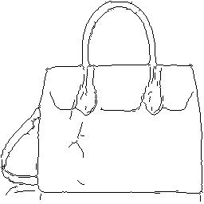
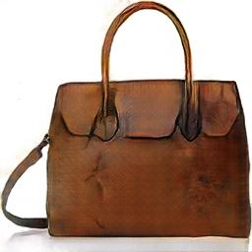

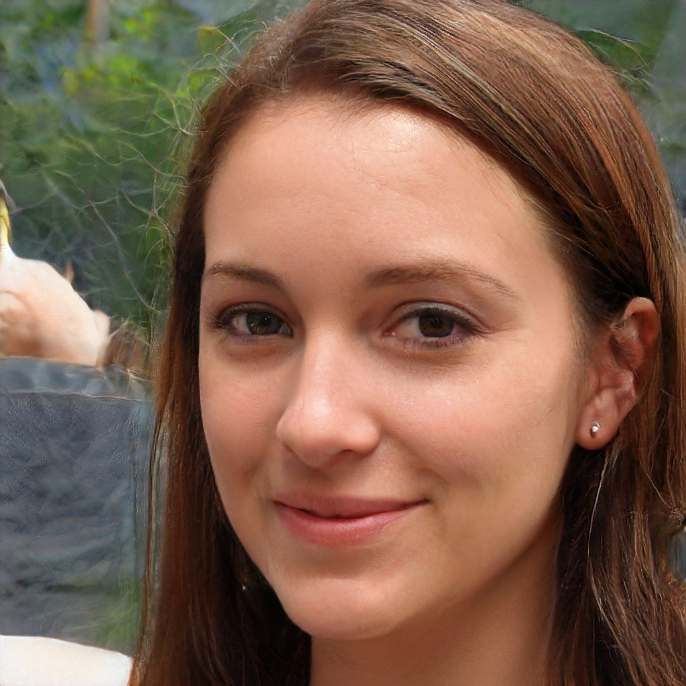
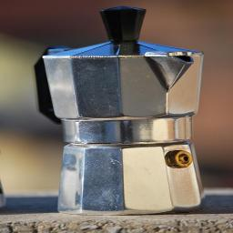
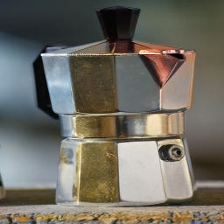
Generative Models
the young men are playing volleyball in the ball .
a lady wearing a blue white shirt is laughing
♪ ♫ ♬ ???

Slide 7
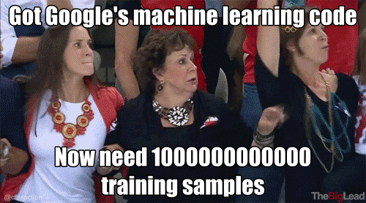
Few-Shot Learning

Slide 8
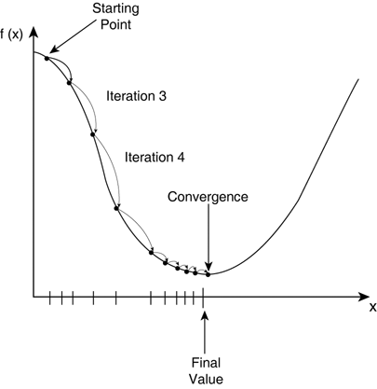
Few-Shot Learning
Solving this would make DL models easier to train
Generalize like humans
Few-Shot Learning (in short): Learning a new function from only a few input/output pairs using prior data from similar tasks

Slide 9
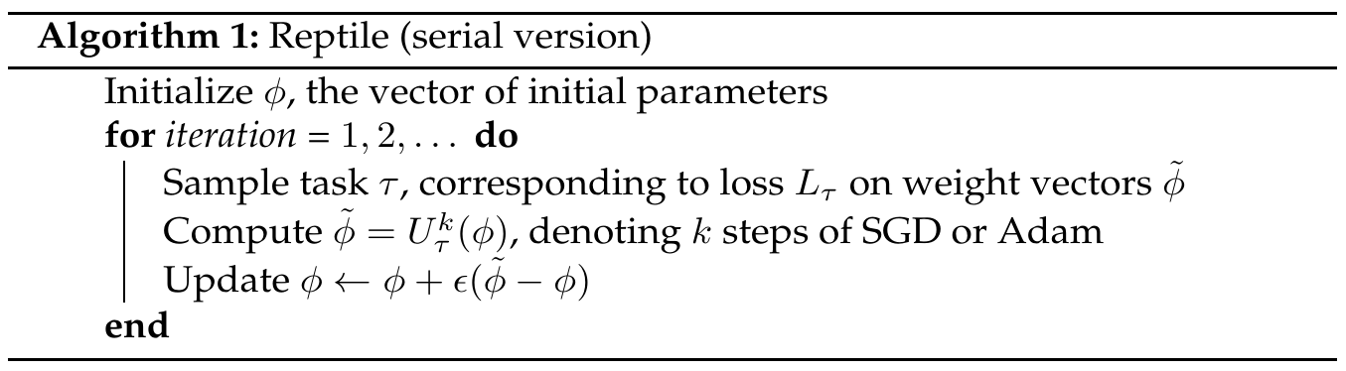
Few-Shot Learning
Reptile (Nichol et. al., 2018): the few-shot solution

Slide 10
Few-Shot Generative Models (same story)
the young men are playing volleyball in the ball .
a lady wearing a blue white shirt is laughing
♪ ♫ ♬ ???

Slide 11
Research
Generative Models + Few-Shot Learning + Music = ???
Research Questions:
To what extent is the music created by a few-shot generative model comparable to the music of a generative model that is trained on a larger dataset?
To what extent is the music created by a few-shot generative model comparable to real music?

Slide 12
Research
Adapt 2 Generative Networks to Reptile:
1. C-RNN-GAN (GAN, 2 LSTM layers, 350 units; Mogren, 2016)
2. Performance RNN (3 LSTM layers 500 units; Oore et. al., 2018)
Baseline: 1 LSTM layer 200 hidden units trained on the whole dataset

Slide 13
Dataset
MAESTRO dataset (Hawthorne et. al., 2018):
1,184 piano expert performances recorded as MIDI
430 individual compositions
6.18 million notes
172 hours of playback

Slide 14
Evaluation
Negative Log Likelihood (standard)
Number of Statistically Different Bins (recommended by Richardson & Weiss, 2018)
Domain-specific (adapted from Mogren, 2016):
Polyphony
Scale Consistency
Repetitions
Tone span

Slide 15
Milestones
Task | Deadline
Develop one-hot encoder/decoder for data | March 15th
Develop domain-specific evaluation tools | March 22nd
Create Keras implementation of PerformanceRNN | March 24th
Create baseline | March 24th
Create Keras implementation of C-RNN-GAN | March 29th
Augment models with Reptile | April 5th
Train Models | April 5th - 19th
Evaluate Models | April 26th
Write thesis | May 12th

Slide 16
References
Goodfellow, I. J., Pouget-Abadie, J., Mirza, M., Xu, B., Warde-Farley, D., Ozair, S., . . . Bengio, Y. (2014). Generative Adversarial Networks. arXiv:1406.2661 [cs, stat]. arXiv: 1406.2661 [cs, Stat]
Mogren, O. (2016). C-RNN-GAN: Continuous recurrent neural networks with adversarial training. arXiv:1611.09904 [cs]. arXiv: 1611.09904 [cs]
Nichol, A., Achiam, J., & Schulman, J. (2018). On First-Order Meta-Learning Algorithms. arXiv:1803.02999 [cs]. arXiv: 1803.02999 [cs]
Hawthorne, C., Stasyuk, A., Roberts, A., Simon, I., Huang, C.-Z. A., Dieleman, S., . . . Eck, D. (2018). Enabling Factorized Piano Music Modeling and Generation with the MAESTRO Dataset. arXiv:1810.12247 [cs, eess, stat]. arXiv: 1810.12247 [cs, eess, stat]
Oore, S., Simon, I., Dieleman, S., Eck, D., & Simonyan, K. (2018). This Time with Feeling: Learning Expressive Musical Performance. arXiv:1808.03715 [cs, eess]. ArXiv: 1808.03715 [cs, eess]
Richardson, E., & Weiss, Y. (2018). On GANs and GMMs. arXiv:1805.12462 [cs]. ArXiv: 1805.12462 [cs]
Graves, A. (2013). Generating Sequences With Recurrent Neural Networks. ArXiv:1308.0850 [Cs]. Retrieved from http://arxiv.org/abs/1308.0850

